Slide 1

Test Driven Infrastructure
Fabio G. Martins


→
https://github.com/fabiogoma
https://www.linkedin.com/in/fabiogoma
fabio.goncalves.martins@ing.nl

Slide 2
Software Development Techniques
Revision Control Systems
Artifact Repositories
Continuous Build
Continuous Integration
Test Driven Development
Behaviour Driven Development
Rubber Duck Debugging
Continuous Delivery

Slide 3
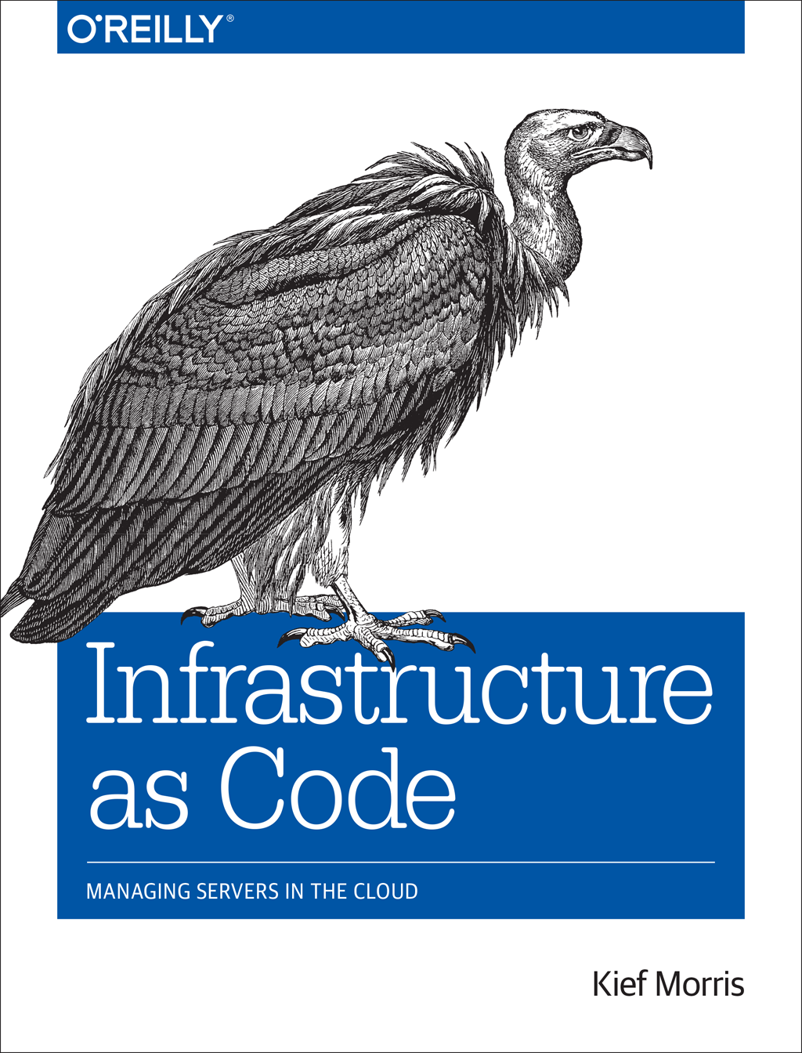
Revision Control Systems
Artifact Repositories
Continuous Build
Continuous Integration
Test Driven Development
Behaviour Driven Development
Continuous Delivery

Slide 4
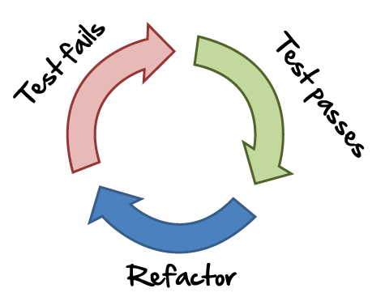
...writing the tests first, watching them fail, and then writing the code to make them pass is a great way to go...
https://kitchen.ci

Slide 5
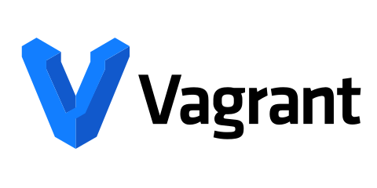



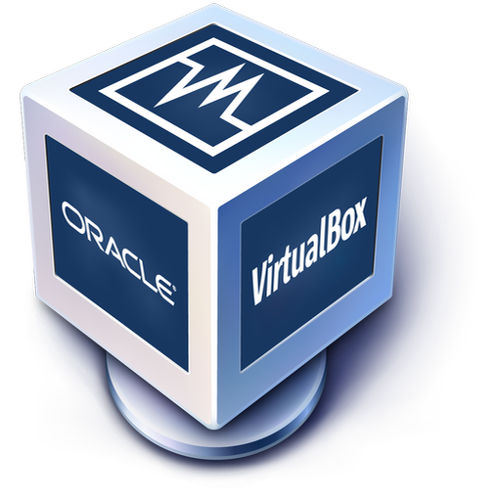





Slide 6
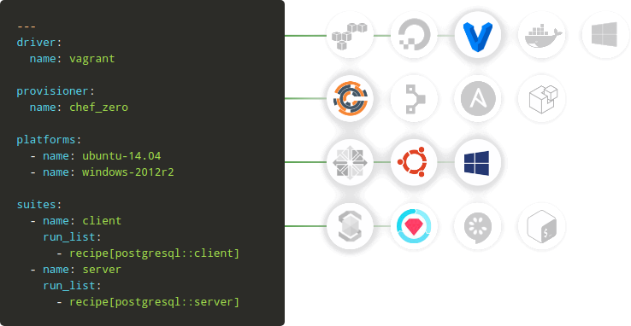

Slide 7
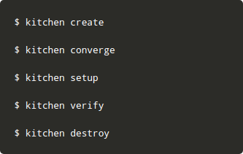

Slide 8
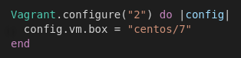

Slide 9
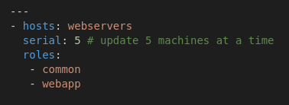

Slide 10
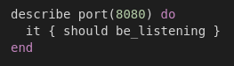

Slide 11
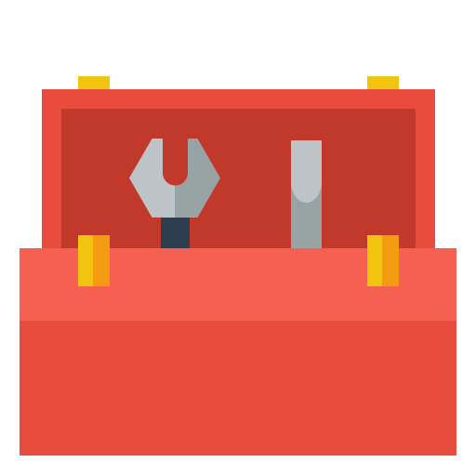
Toolbox
Test Kitchen | https://kitchen.ci/
Vagrant | https://www.vagrantup.com/
Ansible | https://www.ansible.com/
Virtualbox | https://www.virtualbox.org/
Serverspec | http://serverspec.org/

Slide 12

Play time

Slide 13

Questions?

Slide 14

Thank you

